Slide 1
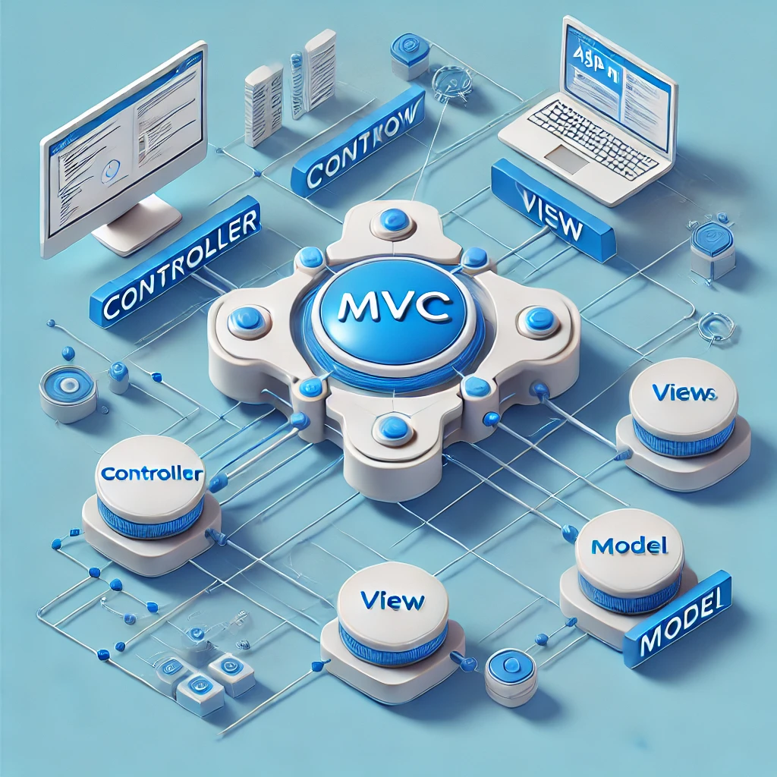
Passing Data Between Views in ASP.NET MVC
Understanding ViewData, ViewBag, TempData

Slide 2

Agenda
Introduction
Understanding ViewData
Understanding ViewBag
Understanding TempData
Comparison Table
Conclusion

Slide 3
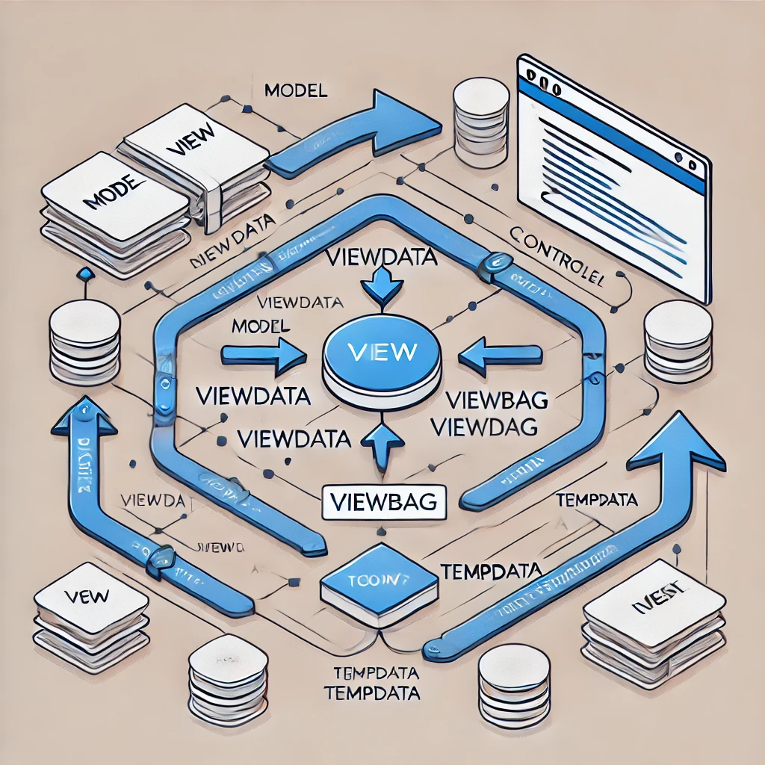
Introduction
Data passing is crucial in ASP.NET MVC as it facilitates communication between the controller and view, enabling dynamic content rendering on web pages.
Techniques for Data Passing:
ViewData – A dictionary-based approach for passing data between controller and view.
ViewBag – A dynamic property wrapper around ViewData for easier data access.
TempData – Used for persisting data between multiple requests.

Slide 4
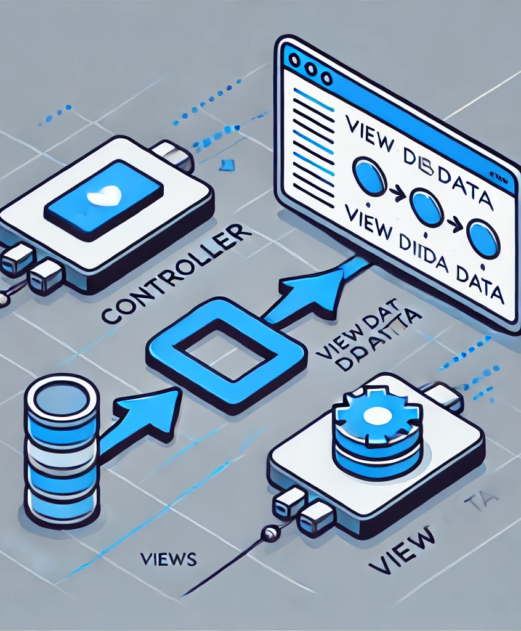
Understanding ViewData
ViewData is a dictionary-based mechanism in ASP.NET MVC that allows data to be passed from the controller to the view.
Weakly Typed – Data is stored as key-value pairs, requiring explicit type conversion when retrieving values.
Available for the Current Request Only – The data is lost once the request is completed, making it unsuitable for passing data between different HTTP requests.
No Compile-Time Checking – Since ViewData stores objects as object, type mismatches can lead to runtime errors.
Stored in a Dictionary – Uses the ViewData Dictionary collection to hold data.

Slide 5
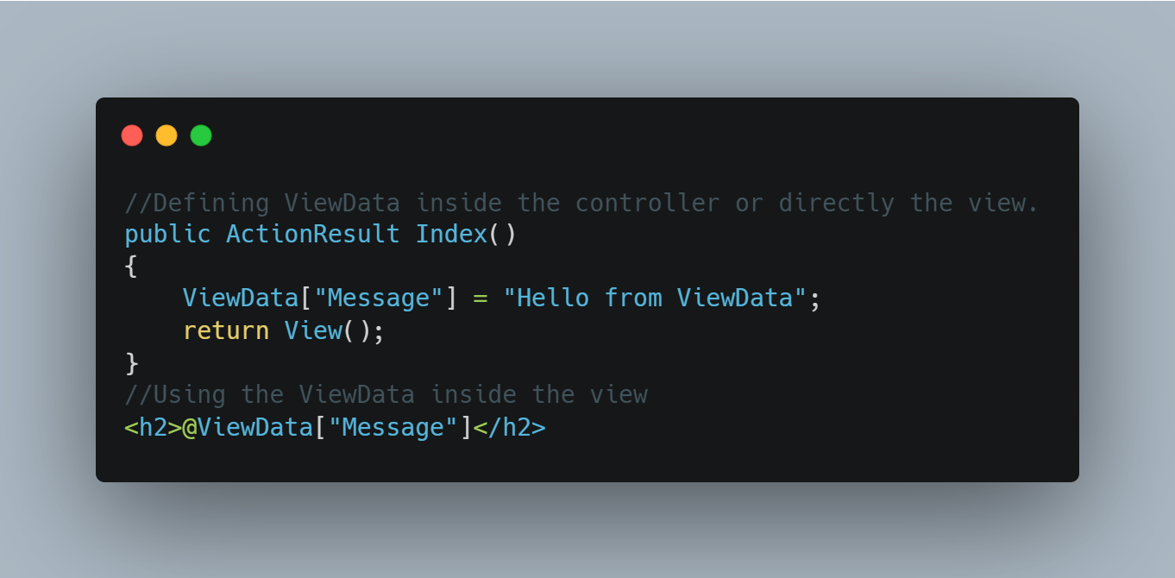
View Data code syntax

Slide 6
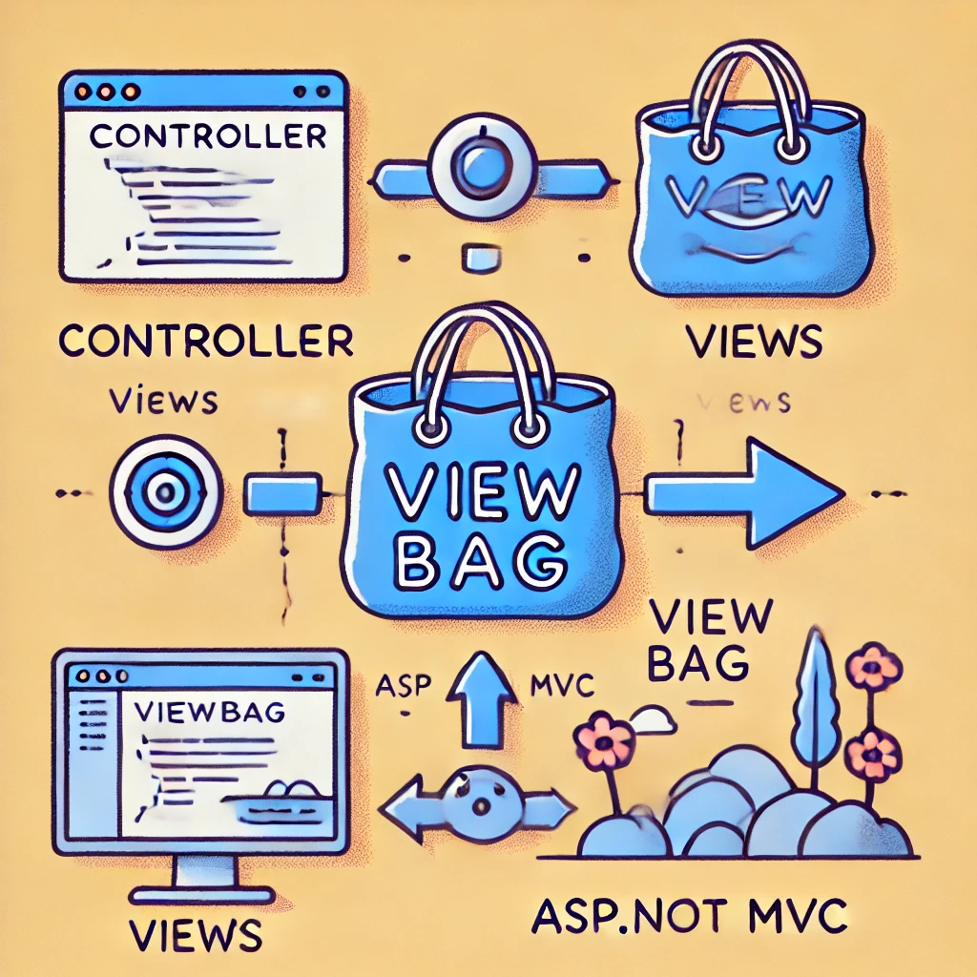
Understanding View Bag
ViewBag is a dynamic wrapper around ViewData that allows data to be passed from the controller to the view without the need for explicit type conversion. It simplifies data handling by using dynamic properties instead of dictionary keys.
Features
Uses Dynamic Properties – Unlike ViewData, which requires dictionary key access, ViewBag allows data to be accessed as properties, making it more readable.
Available for the Current Request Only – The data stored in ViewBag exists only for the duration of the current HTTP request and is lost once the request cycle is complete.
No Need for Type Conversion – Since ViewBag is dynamic, there is no need to explicitly cast data types, reducing the chances of type mismatch errors.
Wrapper Around ViewData – Internally, ViewBag utilizes ViewData, meaning it still stores data in key-value pairs but provides a more convenient way to access it.

Slide 7
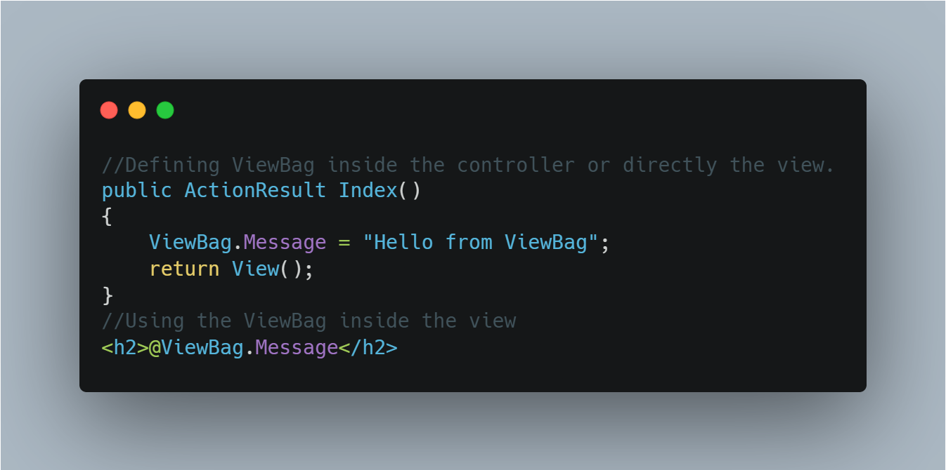
View Bag code syntax

Slide 8
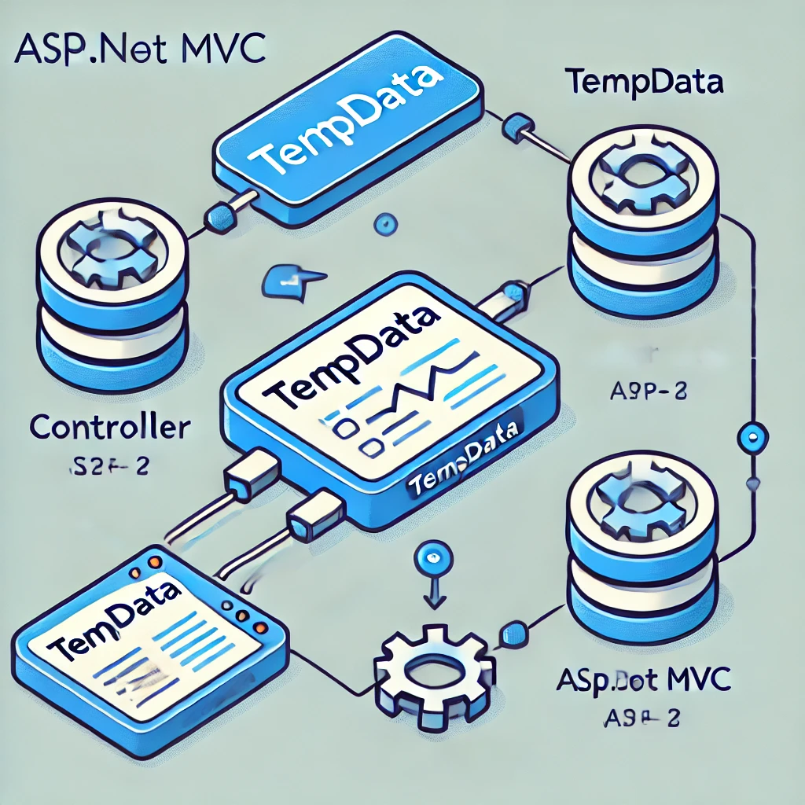
Understanding Temp Data
TempData is a special data storage mechanism in ASP.NET MVC that allows data to be passed between different controllers or actions. Unlike ViewData and ViewBag, which are limited to the current request.
Features
Available Until Read in the Next Request – TempData holds data until it is accessed; once read, it is automatically removed unless explicitly retained.
Uses Session State to Persist Data – It relies on session storage to retain data across requests, ensuring temporary persistence.

Slide 9
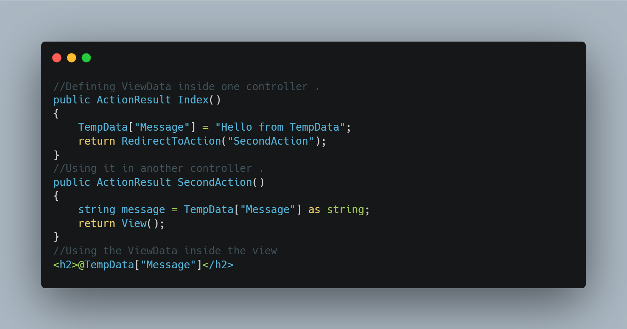
Temp data code syntax

Slide 10
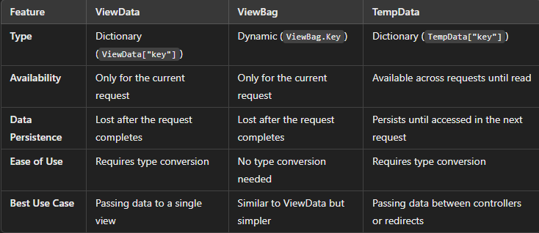
Comparison Table

Slide 11

Thank You

